Slide 1

Using the Power Platform with Finance
Jese Navaranjan

Slide 2
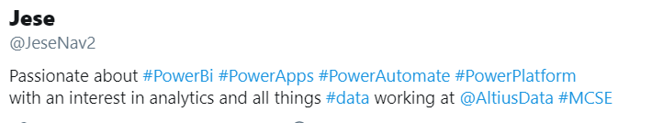


Introducing myself
https://jesepowerbi.wordpress.com/2020/06/01/jeses-power-channel/
https://www.linkedin.com/in/jese-navaranjan-1a836356/
https://twitter.com/JeseNav2
https://www.youtube.com/channel/UC7jwxUwf9RPVWmZplgutj4A?view_as=subscriber
Notes:
5 mins

Slide 3




Power Platform – User Journey
Power Bi Report
Use Power Apps to Submit Forecast to Sharepoint List
Power Automate/Connector refreshes Power Bi report
Notes:
15

Slide 4
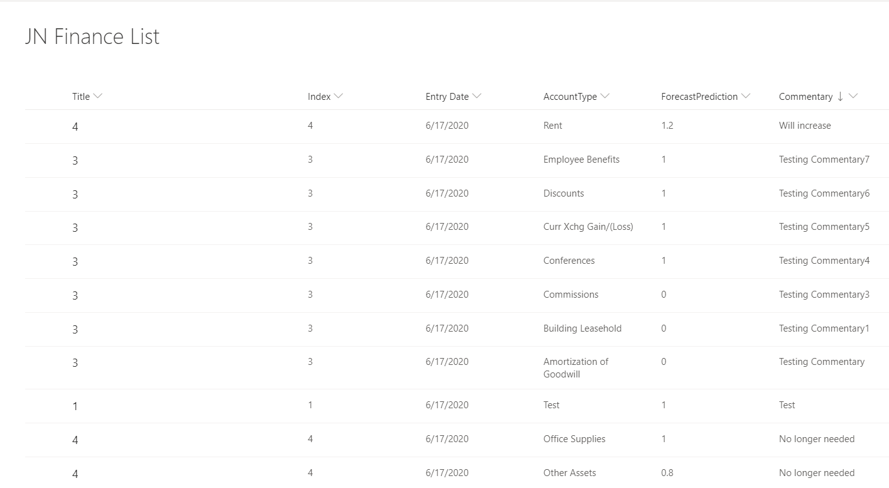
Sharepoint
Notes:
10

Slide 5
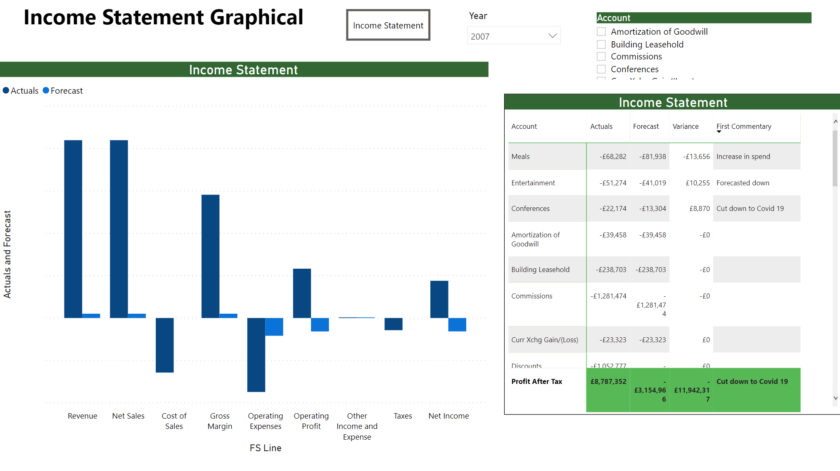
Power Bi
Notes:
10

Slide 6
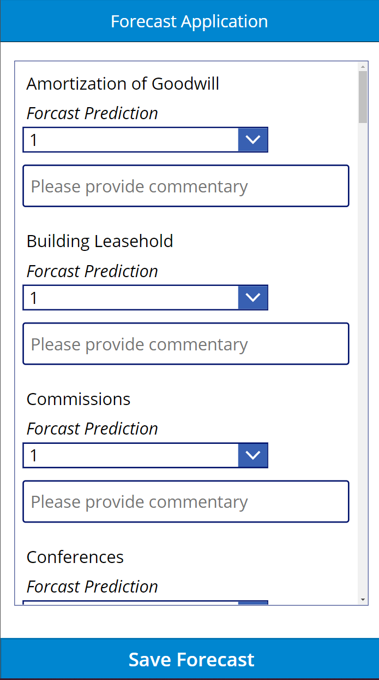
Power App
Notes:
10

Slide 7
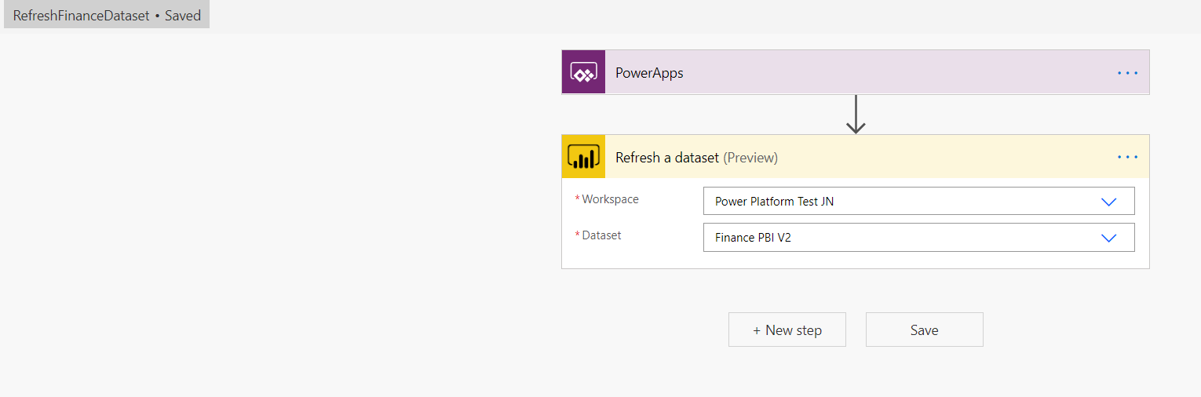
Power Automate/Connector
Notes:
5

